Slide 1


Opportunity Management in Salesforce
Independent Project: Use Salesforce to Close Sales Deals
Basanta Gurung

Slide 2
Part A
Overview
1
Task 1: Update FoodStars.org Opportunity Record
2
Task 2: Update Yaloo Search Opportunity Record
3
Task 3: Use Opportunity Kanban
4
Task 4: Perform a Business Case Analysis

Slide 3
Update FoodStars.Org Opportunity Record
Part A, Task 1:
Insert screenshots for each of these steps on the following slides to show the updates to the FoodStars.org opportunity record.
Make sure you can see the title of the opportunity in your screenshot
Step 1: Past activities showing the call logged with Martha
Step 2: Contact roles section showing Jessie Patel has been added
Step 3: Notes section showing you added a note about licenses
Step 4: Past activities showing the event created to meet with Jessie
Step 5: Past activities showing the task created to confirm budget
Step 6: Sales path showing the opportunity is now in the “Value Proposition” stage

Slide 4
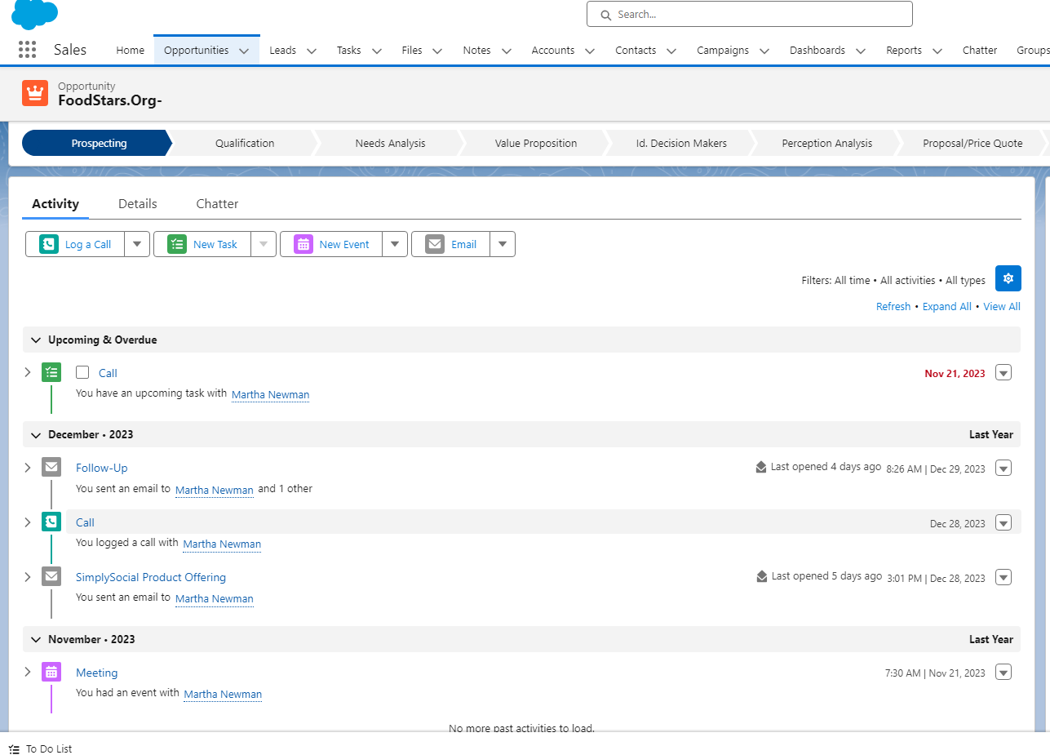
Update FoodStars.Org Opportunity Record
Part A, Task 1:
Martha Call-logged
Insert Part A, Task 1, Step 1 screenshot here.

Slide 5
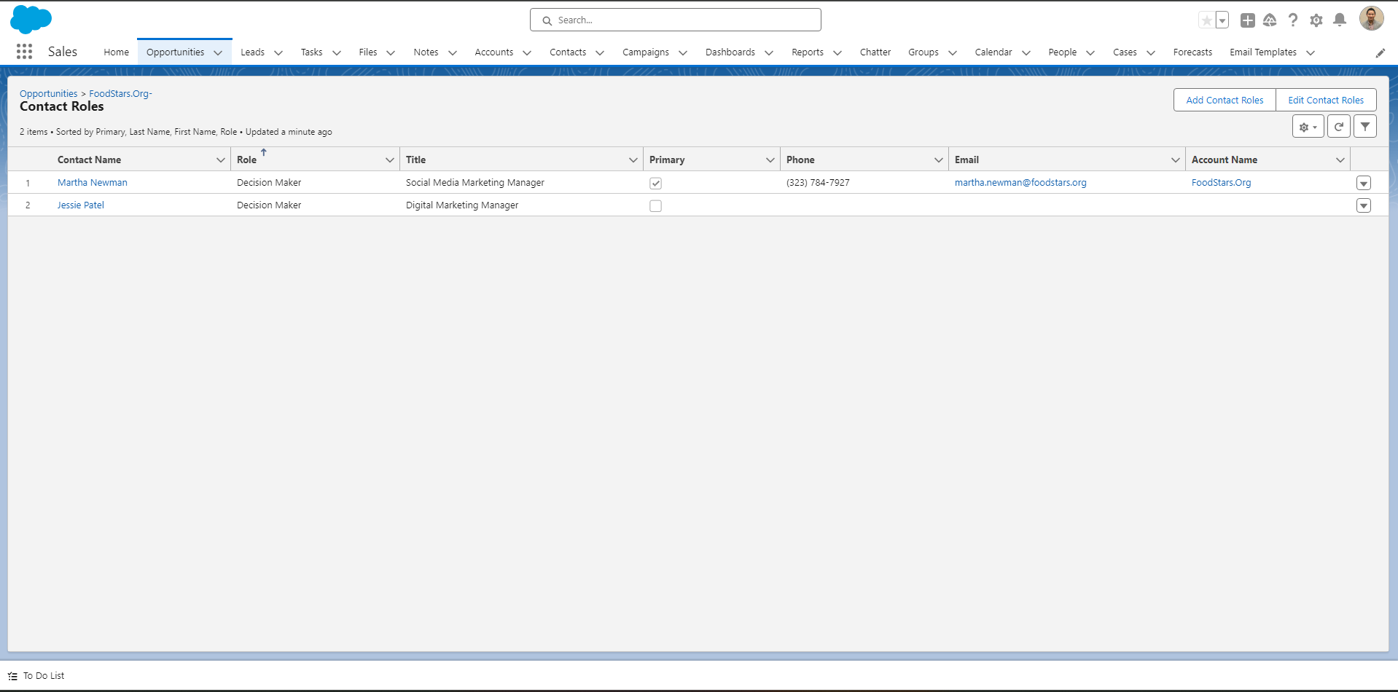
Update FoodStars.Org Opportunity Record
Part A, Task 1:
Insert Part A, Task 1, Step 2 screenshot here.
Contact Roles Added

Slide 6
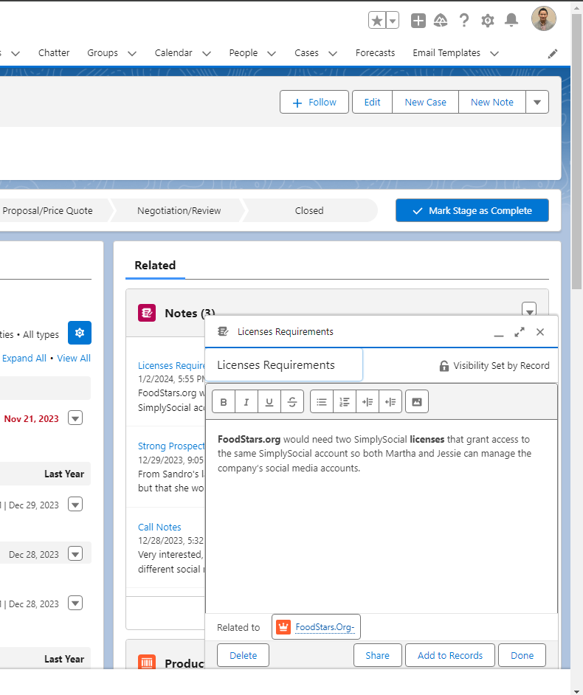
Update FoodStars.Org Opportunity Record
Part A, Task 1:
Insert Part A, Task 1, Step 3 screenshot here.
SimplySocial Licenses Notes

Slide 7
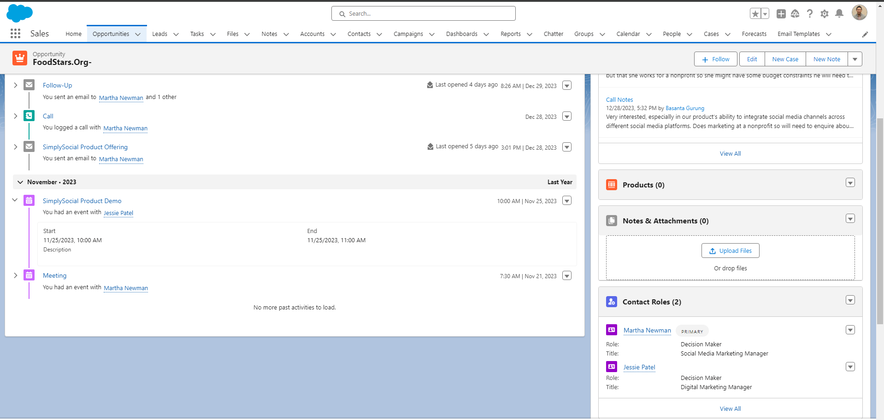
Update FoodStars.Org Opportunity Record
Part A, Task 1:
Insert Part A, Task 1, Step 4 screenshot here.
Product Demo

Slide 8
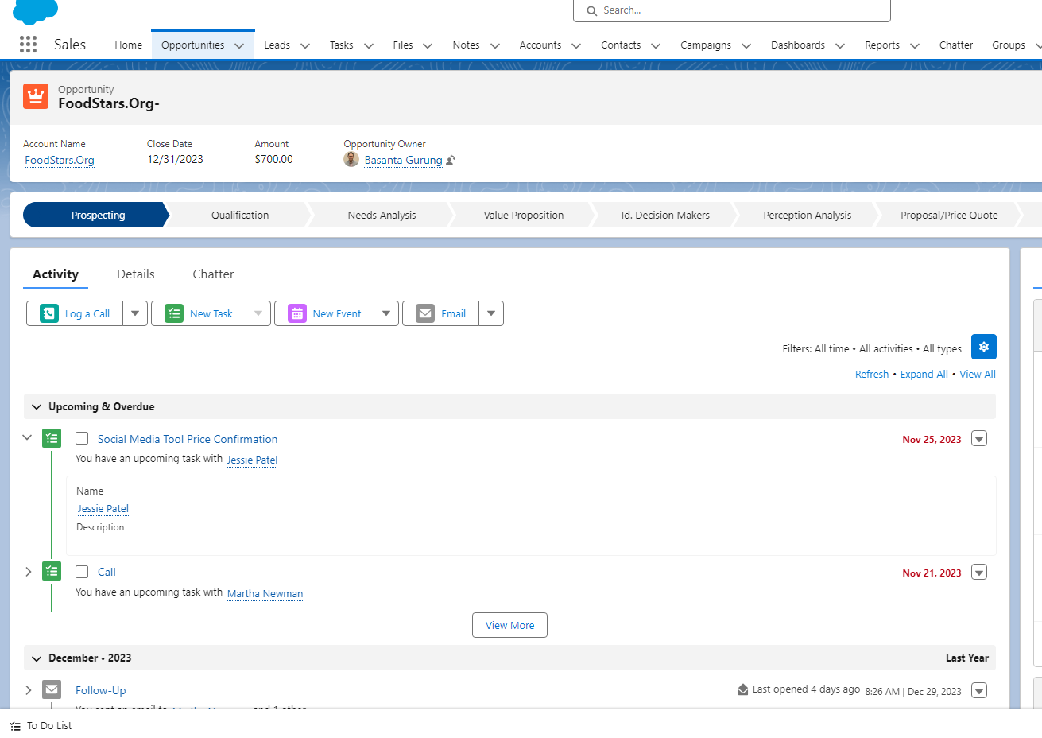
Update FoodStars.Org Opportunity Record
Part A Task 1:
Insert Part A, Task 1, Step 5 screenshot here.
Budget Confirmation Task

Slide 9
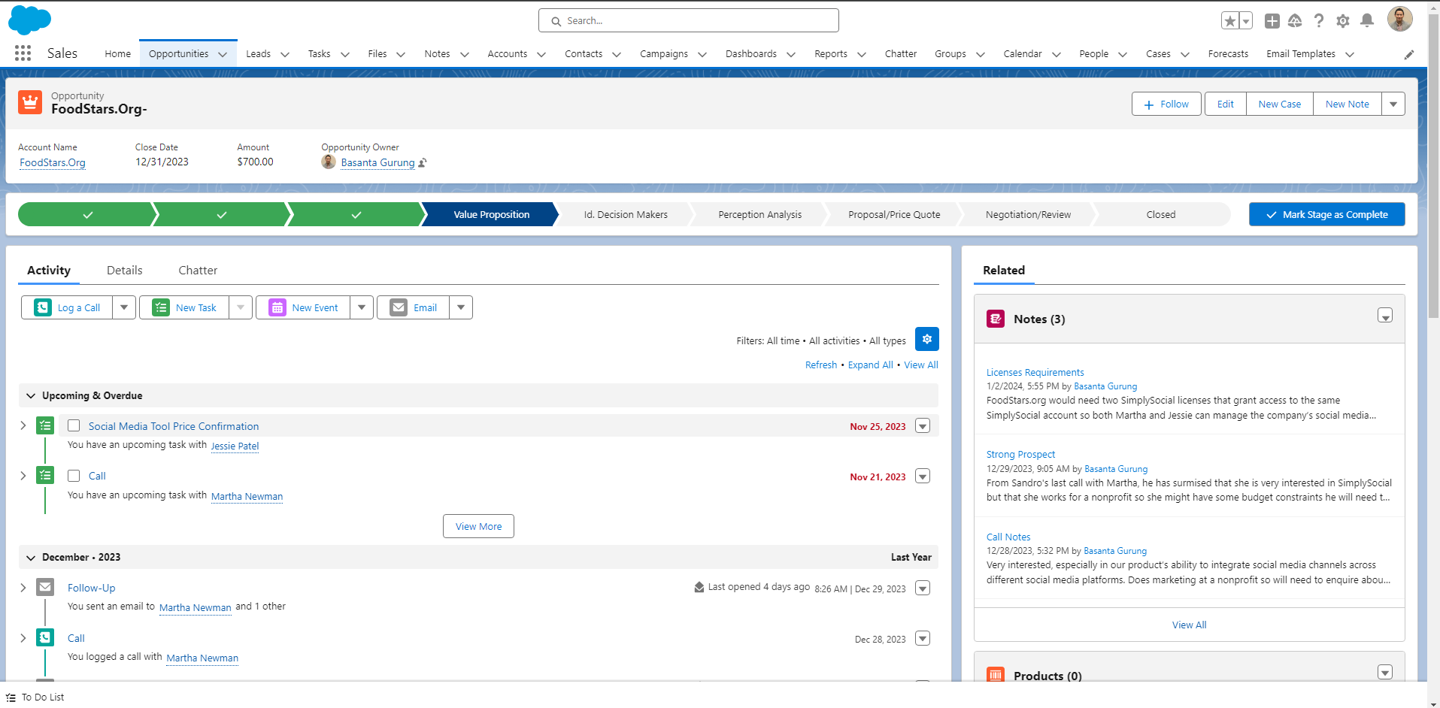
Update FoodStars.Org Opportunity Record
Part A, Task 1:
Value Proposition Stage
Insert Part A, Task 1, Step 6 screenshot here.

Slide 10
Update Yaloo Search
Opportunity Record
Part A, Task 2:
Insert screenshots for each of these steps on the following slides to show the updates to the Yaloo Search opportunity record.
Make sure you can see the title of the opportunity in your screenshot
Step 1: Past activities showing the call logged with Denise
Step 2: Notes section showing you added a note about licenses
Step 3: Details tab showing you updated the opportunity amount
Step 4: Contact roles section showing Kenny and Wonhee have been added
Step 5: Past activities showing the event created for the demo
Step 6: Sales path showing the opportunity is now in the “Needs Analysis” Stage

Slide 11
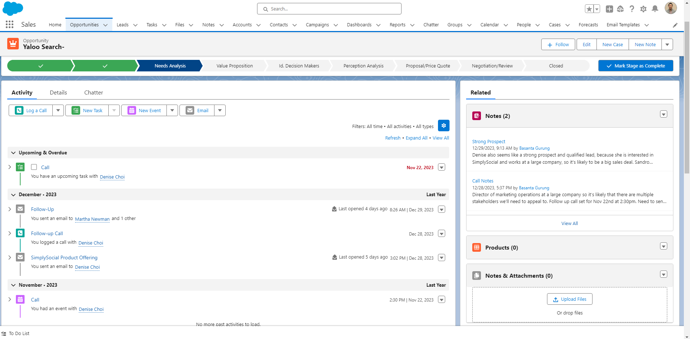
Update Yaloo Search
Opportunity Record
Part A, Task 2:
Denise Choi Call Log
Insert Part A, Task 2, Step 1 screenshot here.

Slide 12
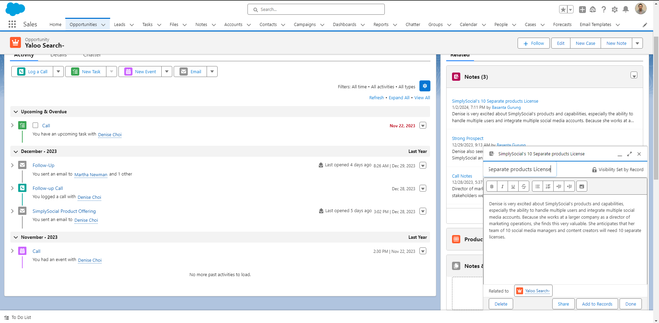
Update Yaloo Search
Opportunity Record
Part A, Task 2:
Insert Part A, Task 2, Step 2 screenshot here.
Yaloo Search Product Licenses Notes

Slide 13
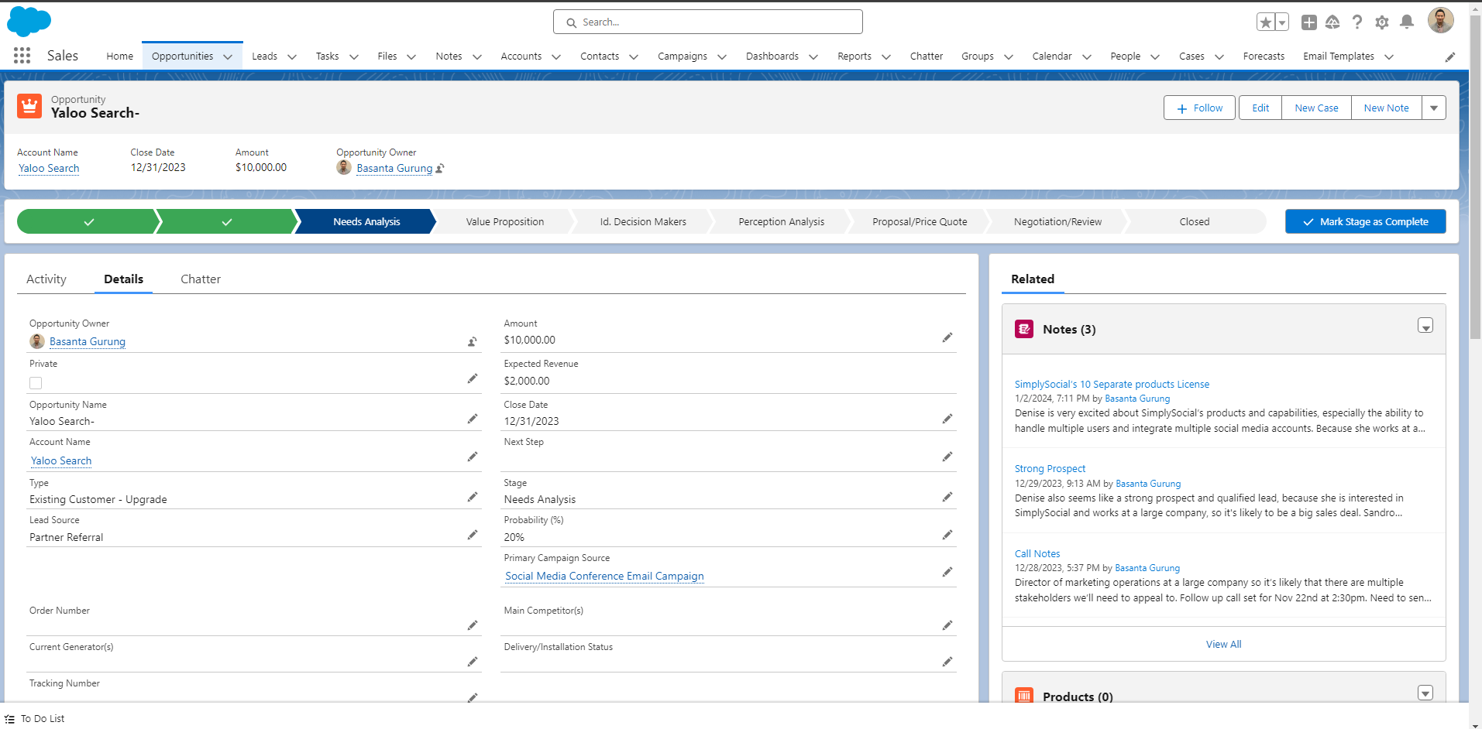
Update Yaloo Search
Opportunity Record
Part A, Task 2:
Marketing Budget
Insert Part A, Task 2, Step 3 screenshot here.

Slide 14
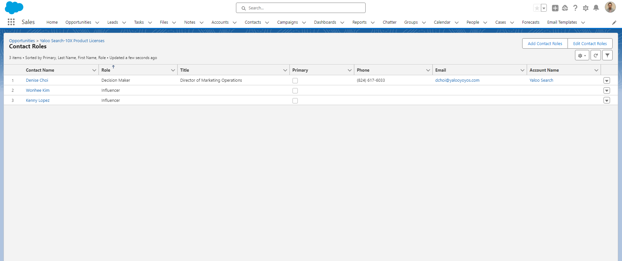
Update Yaloo Search
Opportunity Record
Part A, Task 2:
Insert Part A, Task 2, Step 4 screenshot here.
Contact Roles for Yaloo Search

Slide 15
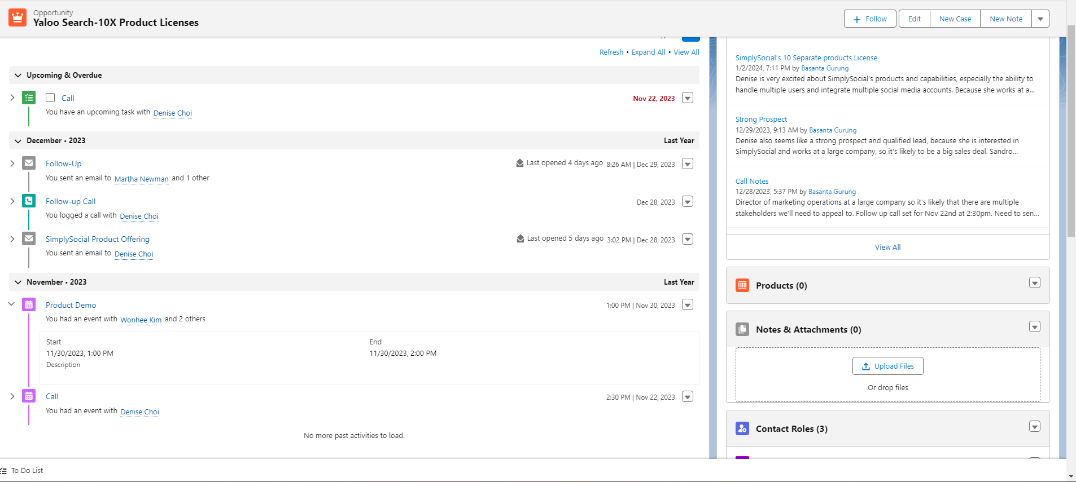
Update Yaloo Search
Opportunity Record
Part A, Task 2:
Insert Part A, Task 2, Step 5 screenshot here.
Product Demo Event

Slide 16
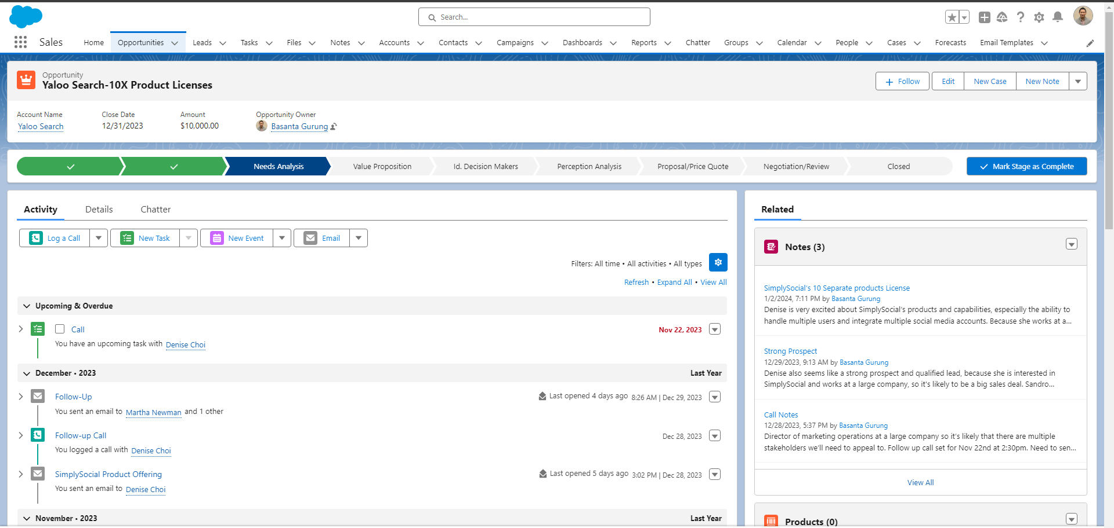
Update Yaloo Search
Opportunity Record
Part A, Task 2:
Need Analysis Stage
Need Analysis Stage

Slide 17
Part A, Task 3: Use Opportunity Kanban
Insert a screenshot showing the updated opportunity Kanban board on the following slide. Make sure it displays which opportunity stages both the FoodStars.org and Yaloo Search opportunities are in as well as the estimated amounts attached to both.

Slide 18
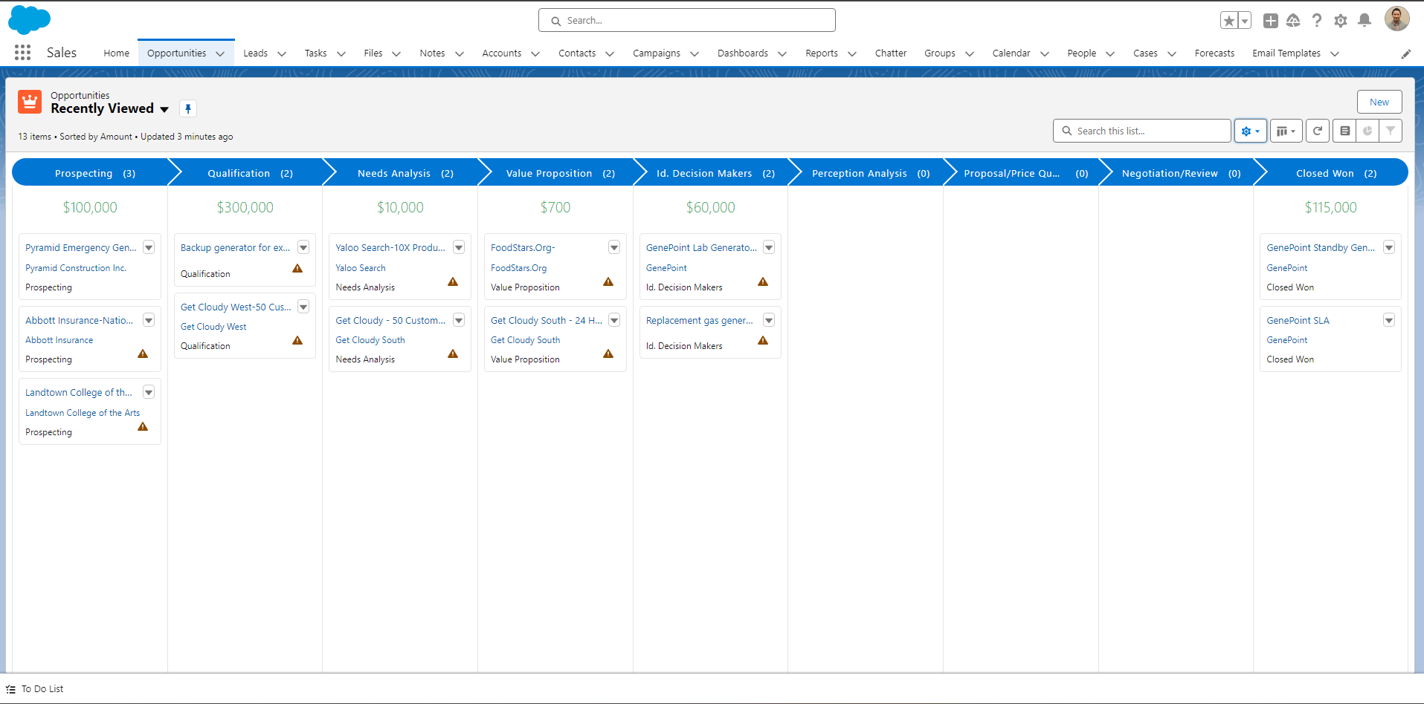
Part A, Task 3: Use Opportunity Kanban
Kanban Opportunity Stages
Insert Part A, Task 3 screenshot here.

Slide 19
Part A, Task 4: Business Case Analysis
In a short paragraph, describe how updating opportunity records, progressing opportunities through stages, and using opportunity Kanban in Salesforce would help SimplySocial's team of account executives sell better and more efficiently. In your description, include:
The overall purpose of opportunity records, opportunity stages, and opportunity Kanban
The steps you took to help the AE organize and progress opportunities through the stages.
How a company like SimplySocial would benefit from using opportunities and opportunity stages

Slide 20
Part A, Task 4: Business Case Analysis
Updating opportunity records, progressing opportunities through stages, and utilizing the opportunity Kanban in Salesforce significantly enhance a SimplySocial's sales efficiency and effectiveness for a team of account executives. By consistently updating opportunity records, the team ensures that information is current and accurate, providing a real-time view of each potential deal's status, value, and associated details. Progressing opportunities through stages allows for a structured and transparent sales process, enabling account executives to track and manage deals at every phase.
The use of the opportunity Kanban provides a visual representation of the entire sales pipeline, allowing the team to quickly identify opportunities at different stages, prioritize tasks, and address bottlenecks. This streamlined approach not only fosters better communication and collaboration within the team but also empowers account executives to make informed decisions, ultimately resulting in improved sales performance and efficiency.

Slide 21

You have reached the end of Part A!
Make sure your screenshots are embedded in the appropriate slides before moving on. Note that you will complete Part B of this Independent Project at the end of Week 4.

Slide 22
Part B
Overview
1
Task 1: Create Products
2
Task 2: Create Standard Price Books
3
Task 3: Create Custom Price Books
4
Task 4: Associate Price Books With Opportunities
5
Task 5: Create Quotes
6
Task 6: Send Quotes
7
Task 7: Close the Deal
8
Task 8: Create Contracts

Slide 23
Part B, Task 1: Create Products
Insert screenshots for each of the new products you create. Make sure that you screenshot the product record page showing the name of the product as well as all the product details according to the specifications in the instructions.
Step 1: Product record page for the single license subscription product
Step 2: Product record page for the subscription package product
Step 3: Product record page for the subscription package plus product
Step 4: Product record page for the extra user license product

Slide 24
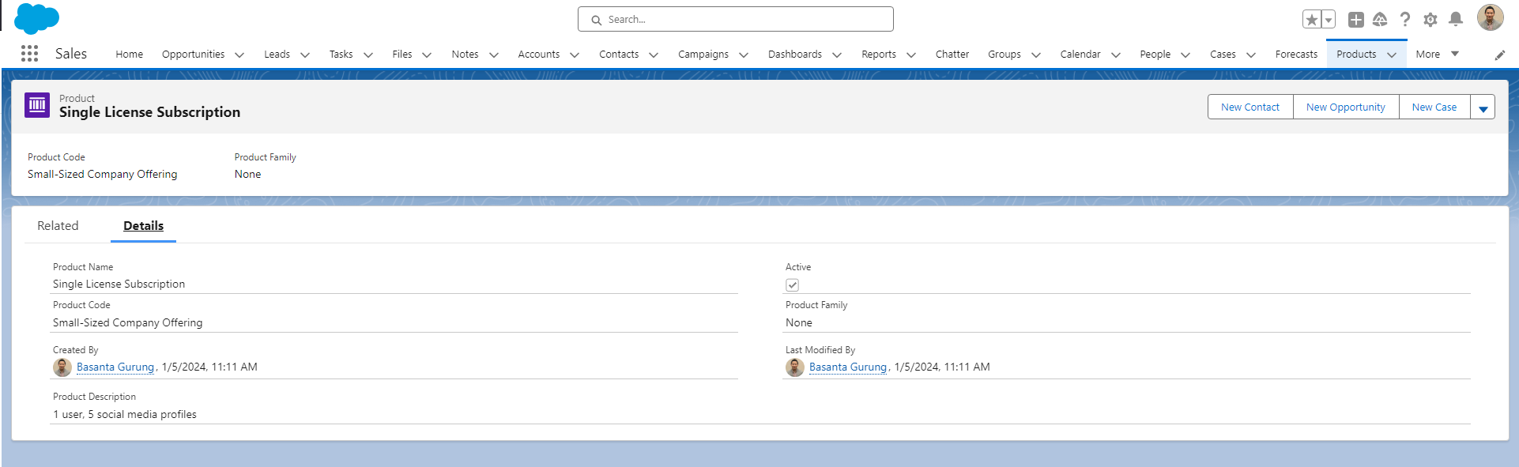
Part B, Task 1: Create Products
Insert Part B, Task 1, Step 1 screenshot here.
Single License Subscription

Slide 25
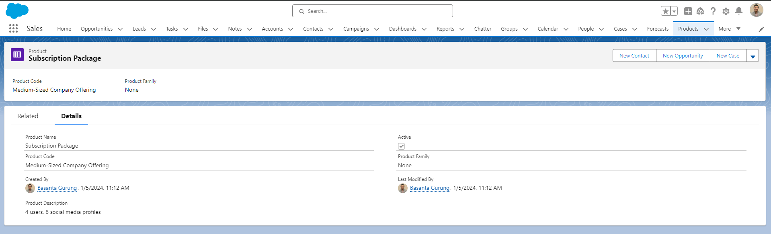
Part B, Task 1: Create Products
Mid-Sized License Subscription
Insert Part B, Task 1, Step 2 screenshot here.

Slide 26
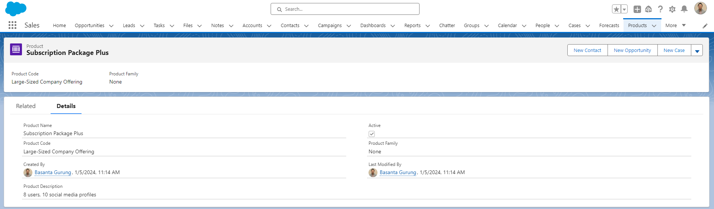
Part B, Task 1: Create Products
Subscription Plus License
Insert Part B, Task 1, Step 3 screenshot here.

Slide 27
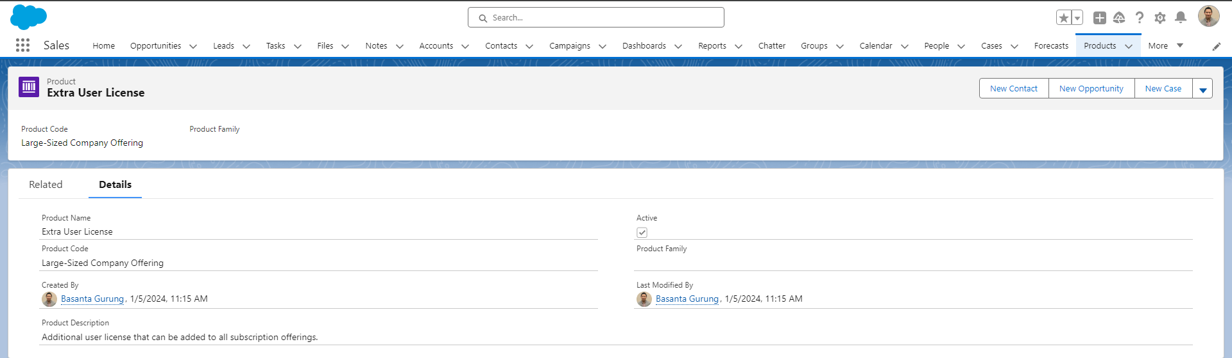
Part B, Task 1: Create Products
Insert Part B, Task 1, Step 4 screenshot here.
Extra User License

Slide 28
Part B, Task 2: Create Standard Price Books
Insert screenshots showing the standard price book entry, or list price, you’ve added for each of the products you created. Make sure your screenshot shows the name of the product as well as the standard price book and list price entry.
Step 1: Standard price book for the single license subscription product
Step 2: Standard price book for the subscription package product
Step 3: Standard price book for the subscription package plus product
Step 4: Standard price book for the extra user license product

Slide 29
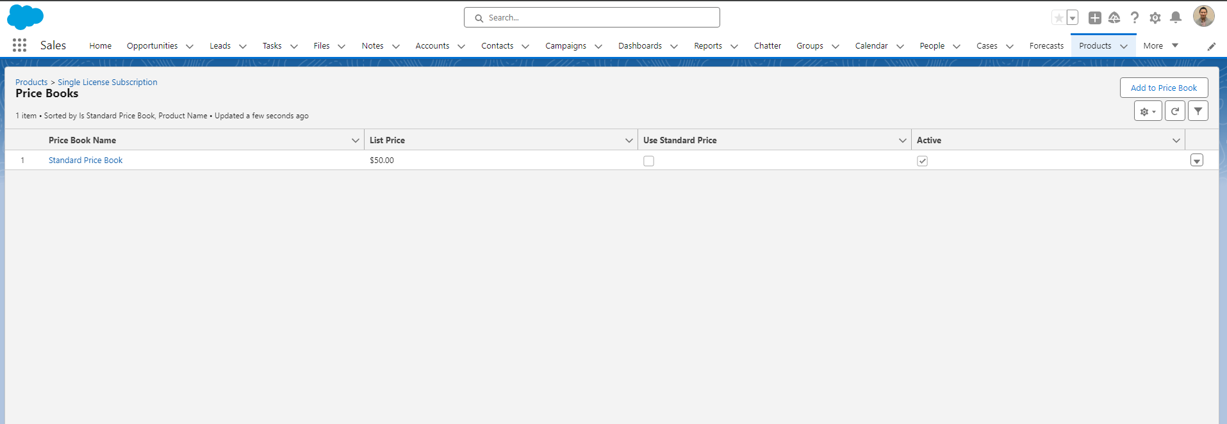
Part B, Task 2: Create Standard Price Books
Insert Part B, Task 2, Step 1 screenshot here.
Single License Subscription Price Book

Slide 30
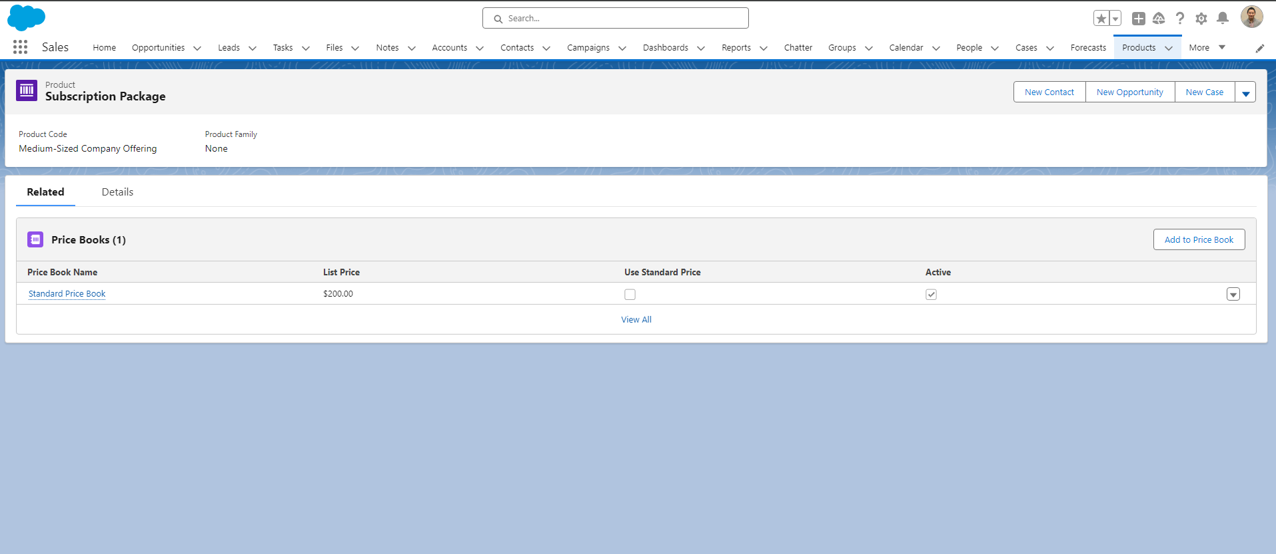
Part B, Task 2: Create Standard Price Books
Insert Part B, Task 2, Step 2 screenshot here.
Standard Subscription Package Price Book

Slide 31
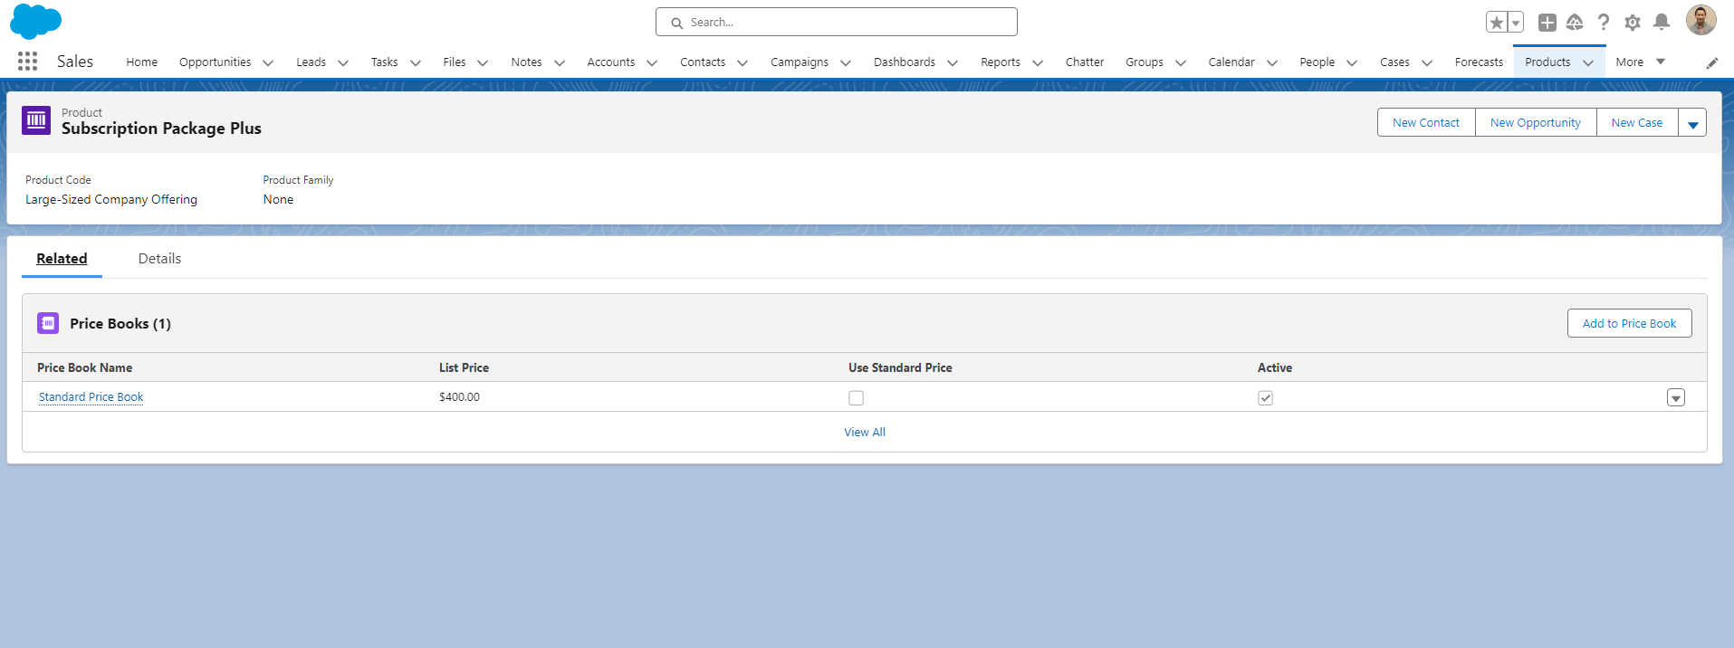
Part B, Task 2: Create Standard Price Books
Insert Part B, Task 2, Step 3 screenshot here.
Subscription Package Plus Price Book

Slide 32
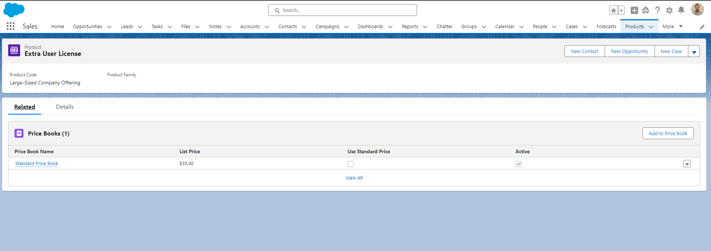
Part B, Task 2: Create Standard Price Books
Insert Part B, Task 2, Step 4 screenshot here.
Extra User License Price Book

Slide 33
Part B, Task 3: Create Custom Price Books
Insert screenshots related to the custom price books you create, according to the following instructions:
Step 1: The new price book for nonprofit customers you just created
Step 2: The new price book for enterprise customers you just created
Step 3: The updated price book for enterprise customers with the associated products
Step 4: The updated price book for nonprofit customers with the associated products showing the new prices

Slide 34
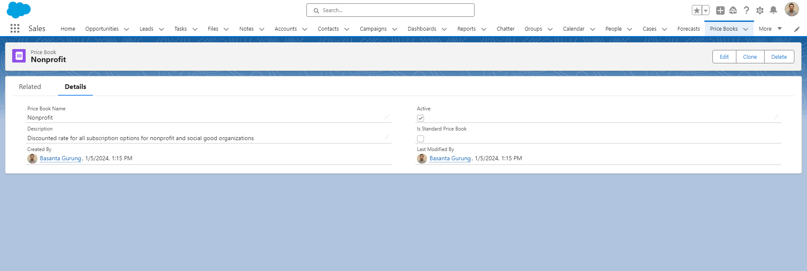
Part B, Task 3: Create Custom Price Books
Nonprofit Price Book
Insert Part B, Task 3, Step 1 screenshot here.

Slide 35
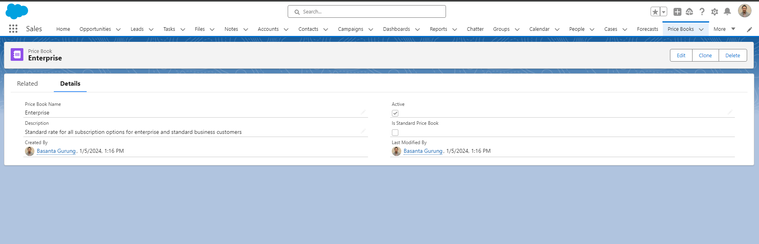
Part B, Task 3: Create Custom Price Books
Enterprise Price Book
Insert Part B, Task 3, Step 2 screenshot here.

Slide 36
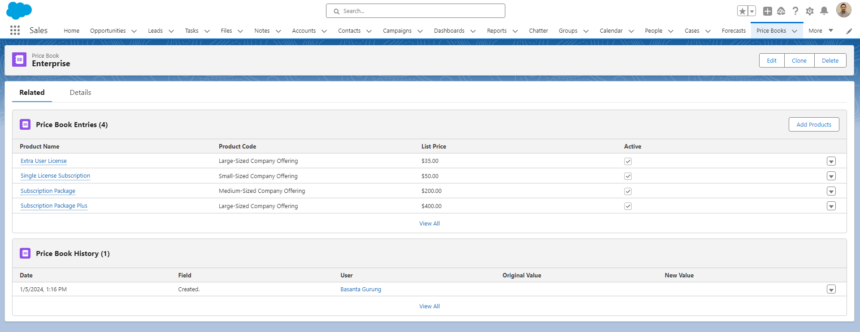
Part B, Task 3: Create Custom Price Books
Insert Part B, Task 3, Step 3 screenshot here.
Enterprise Price Book with Products

Slide 37
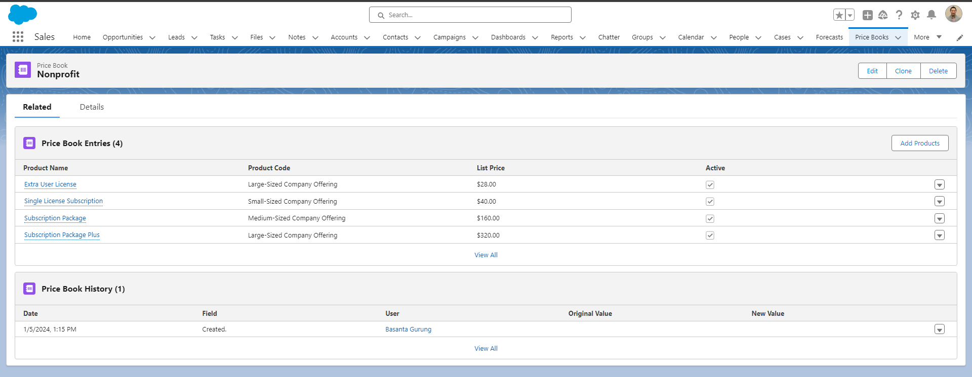
Part B, Task 3: Create Custom Price Books
Discounted Nonprofit Price Book
Insert Part B, Task 3, Step 4 screenshot here.

Slide 38
Associate Price Books
With Opportunities
Part B, Task 4:
Insert screenshots of your two in-progress opportunities showing the correct price books and products added to the products section of the opportunity record page. For each screenshot, make sure the opportunity name is visible, along with the associated products and the correct prices, according to the following instructions:
Step 1: FoodStars.Org opportunity record showing products/prices
Step 2: Yaloo Search opportunity record showing products/prices

Slide 39
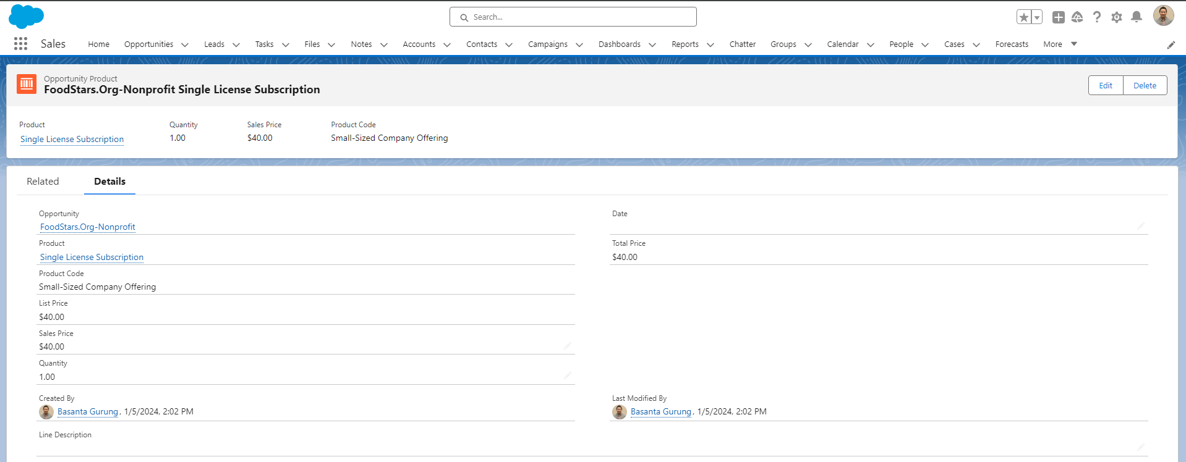
Associate Price Books
With Opportunities
Part B, Task 4:
Insert Part B, Task 4, Step 1 screenshot here.
FoodStars.org Product and Price

Slide 40
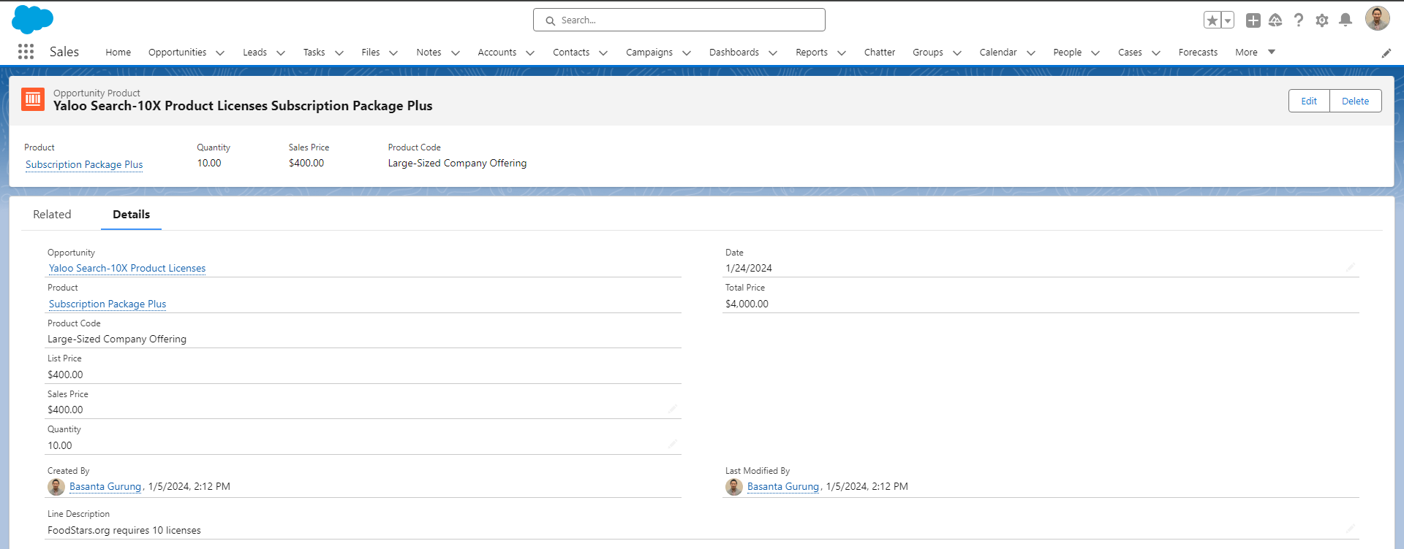
Associate Price Books
With Opportunities
Part B, Task 4:
Enterprise Product and Price
Insert Part B, Task 4, Step 2 screenshot here.

Slide 41
Part B, Task 5: Create Quotes
On the following slide, insert a screenshot of the Initial Quote record page for the Yaloo Search opportunity that you just made. Make sure your screenshot shows the name of the quote, the name of the account and opportunity, the quote line items, the grand total, and the updated quote status.

Slide 42
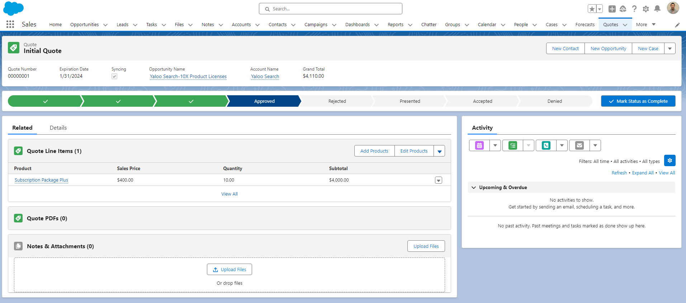
Part B, Task 5: Create Quotes
Yaloo Search Initial Quote
Insert Part B, Task 5 screenshot here.

Slide 43
Part B, Task 6: Send Quotes
Insert screenshots related to the quote you generated on the following slides.
Step 1: The PDF preview of the initial quote
Step 2: The draft email containing the PDF of the initial quote that you will send to Denise.
Make sure that the PDF attachment is visible in the email.

Slide 44
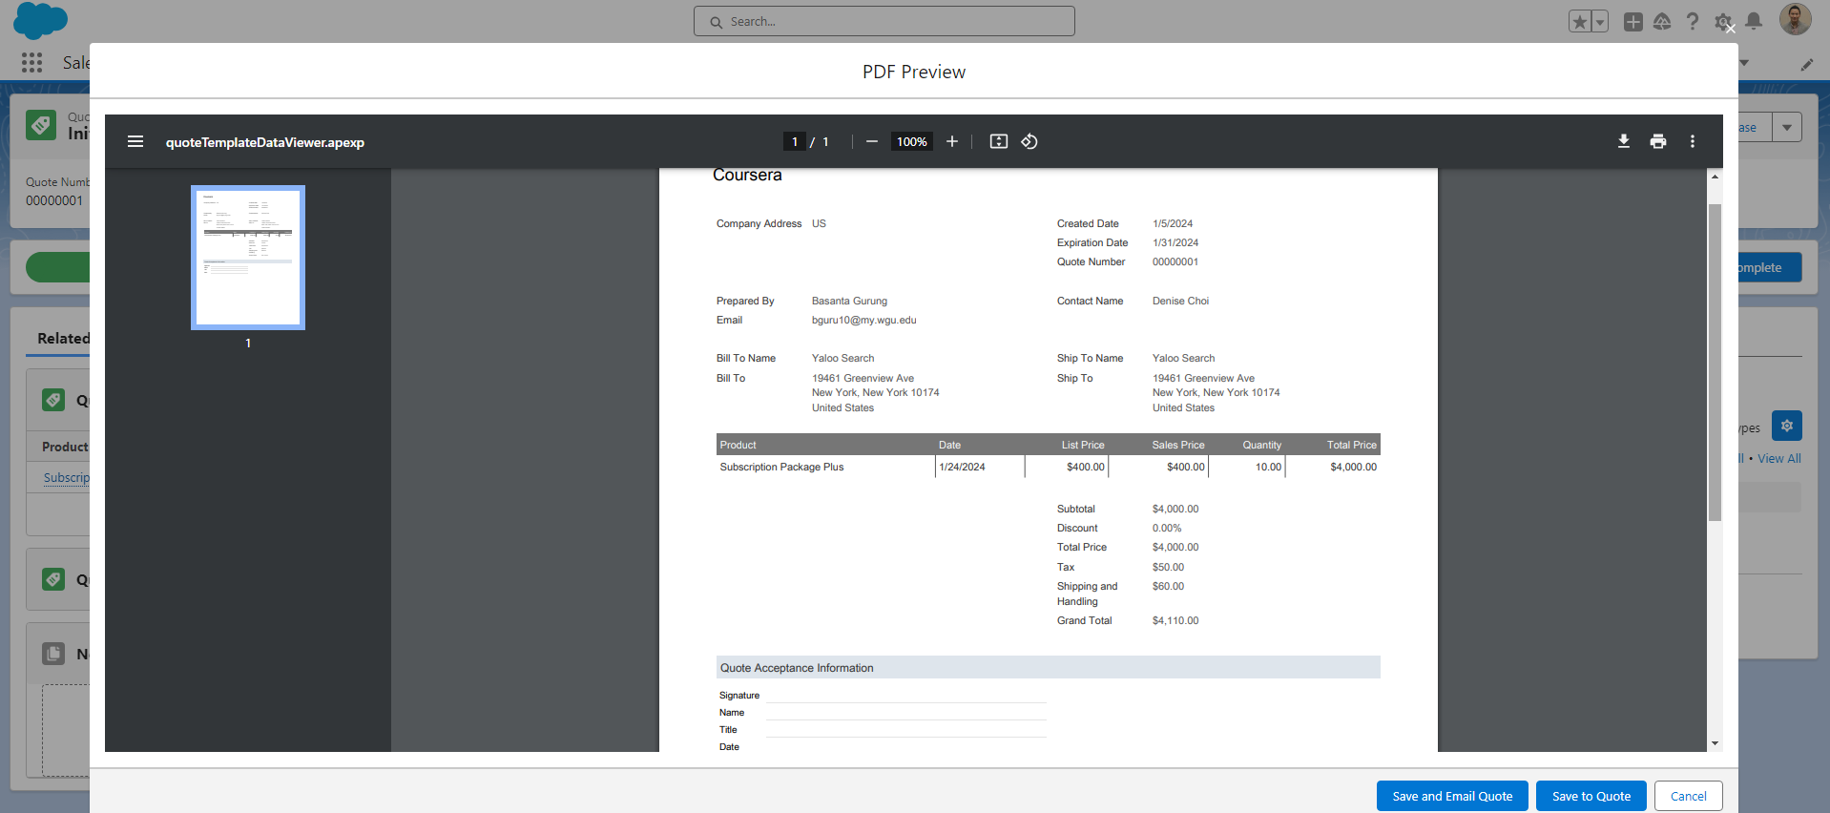
Part B, Task 6: Send Quotes
PDF Preview of Initial Quote
Insert Part B, Task 6, Step 1 screenshot here.

Slide 45
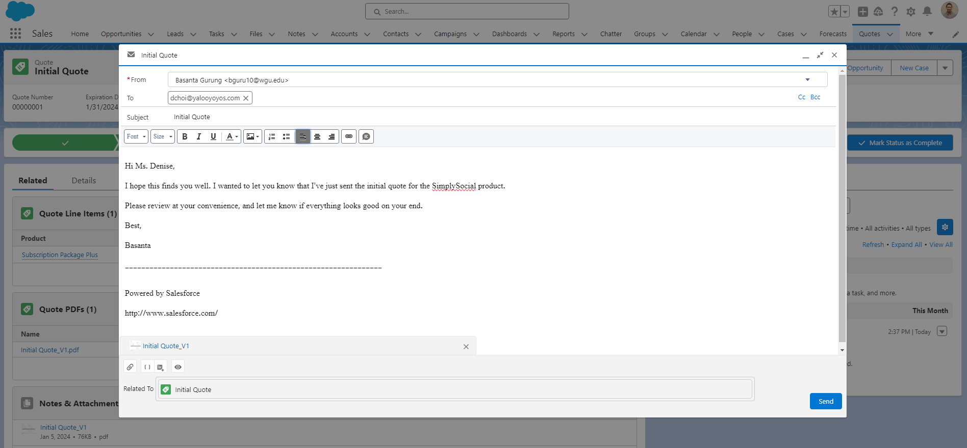
Part B, Task 6: Send Quotes
Email Quote with PDF
Insert Part B, Task 6, Step 2 screenshot here.

Slide 46
Part B, Task 7: Close the Deal
Insert screenshots on the following slides showing you’ve correctly closed the Yaloo Search and FoodStars.org opportunities.
Step 1: Close the Yaloo Search opportunity as won.
Make sure your screenshot shows the opportunity stage status updated accordingly.
Step 2: Close the FoodStars.org opportunity as lost.
Make sure your screenshot show the opportunity stage updated accordingly and the note you created explaining why it was closed.

Slide 47
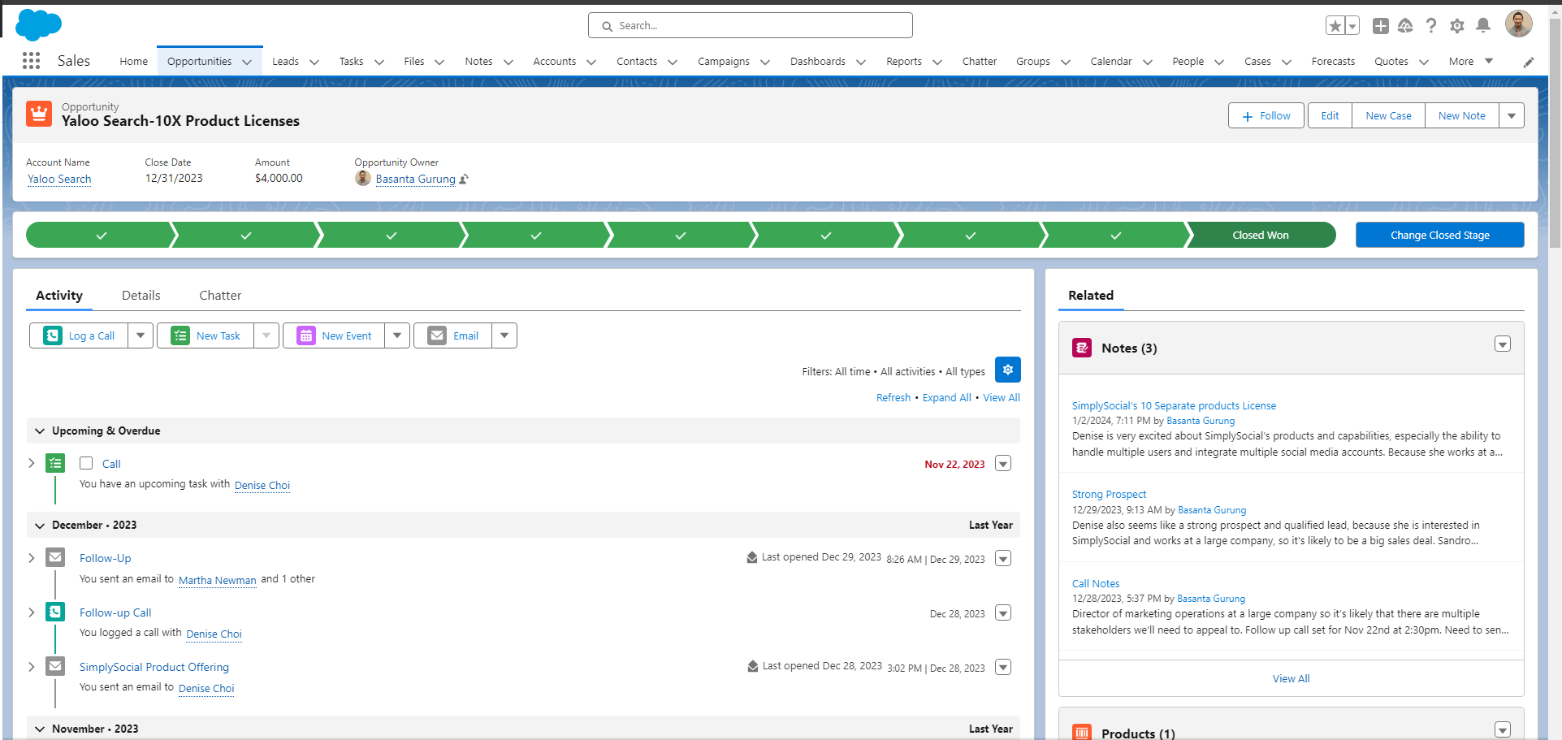
Part B, Task 7: Close the Deal
Yaloo Search Deal Won
Insert Part B, Task 7, Step 1 screenshot here.

Slide 48
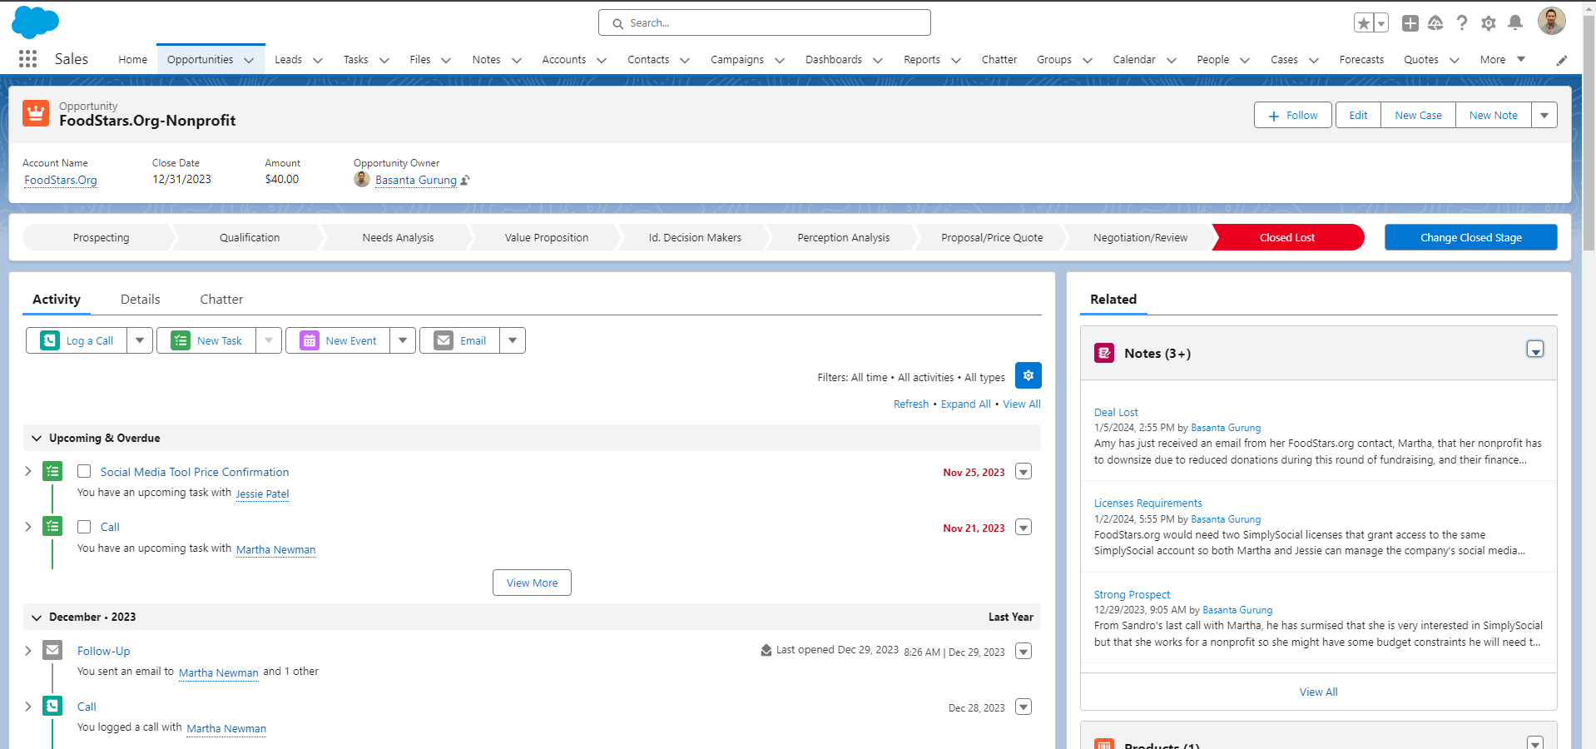
Part B, Task 7: Close the Deal
FoodStars.org Deal Lost
Insert Part B, Task 7, Step 2 screenshot here.

Slide 49
Part B, Task 8: Create Contracts
On the following slide, insert a screenshot of the new contract for Yaloo Search that you’ve just created. Make sure the account name, status, and contract term are visible.

Slide 50
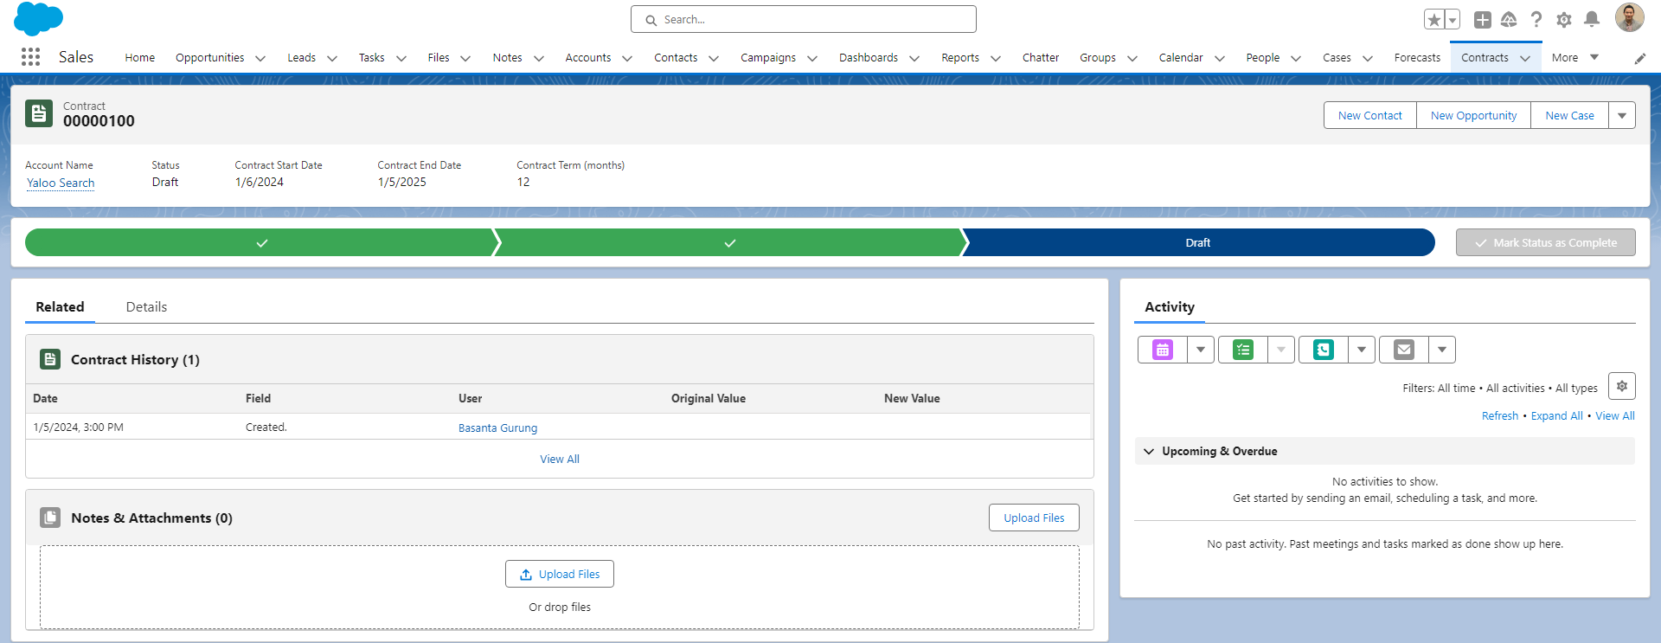
Part B, Task 8: Create Contracts
Contract for Yaloo Search
Insert Part B, Task 8 screenshot here.

Slide 51
You have reached the end of Part B!
This is the end of this Independent Project! Great job completing all these tasks in Salesforce. Make sure you download a copy of this deck for your portfolio.

